Slide 1
Mail Client
Department Of Computer Science & Enginering
ADITYA ENGINEERING COLLEGE

Slide 2
ABSTRACT
An e-Mail client is an email program; software designed to collect and send electronic mail.
It is also referred to as an email program, or mail user agent (MUA) , used in email headers.

Slide 3
ABSTRACT
Networking standards have been established to make exchange of messages possible from a virtual unlimited pool of clients.
The “addressing” information is included in the headers, along with the name of the email program as the “mail user agent.”

Slide 4
ABSTRACT
Software requirements:
Operating System: Windows, Linux
Software’s: Java SDK 2, Borland JBuilder , Eclipse

Slide 5
ABSTRACT
HARDWARE REQUIREMENTS:
No of Systems: 2 - Client & Server (Minimum)
Processor: Intel P4 (Or equivalent)
Hard Disk : 40 GB
RAM: 512 MB (minimum)
Network: Standard Wired/Wireless network with either Ad-hoc or infrastructure mode

Slide 6
TECHNOLOGY
JAVA :
HISTORY:
Java is a programming language developed by James -Gosling at Sun Microsystems and released in 1995.
The language, initially called Oak after an oak tree that stood outside Gosling's office, later renamed as Java
FEATURES:
Portability
Security
Inheritance
Encapsulation
Polymorphism

Slide 7
DESCR
I
PT
I
ON:
MAIL CLIENT:
An email client is software that allows you to read and send email through your account by connecting to this server.
Email clients generally provide a simple interface through which you can access your email account.
Ex:- IU Webmail, Thunderbird, Eudora, Mac OS X Mail, Outlook Express

Slide 8
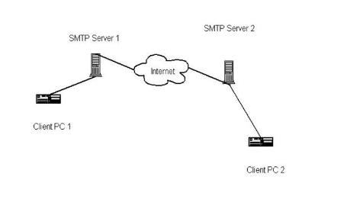
DESCR
I
PT
I
ON

Slide 9
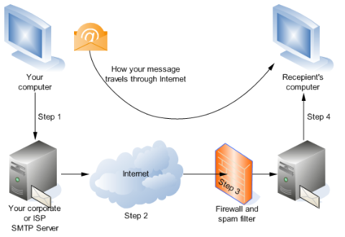
DESCR
I
PT
I
ON
Travelling of emails:

Slide 10
DESCR
I
PT
I
ON
JAVA MAIL API:
Introduction
The JavaMail API is a fairly high-level representation of the basic components of any email system.
The abstract class javax.mail.Message represents an email message.
JavaMail is a Java API used to receive and send email via SMTP,POP3 and IMAP.
The JavaMail API defines classes such as Message, Store, and Transport.

Slide 11
DESCR
I
PT
I
ON
SOCKET:
A socket(Internet socket)software object that connects an application to a network protocol
In Java, a program can send and receive TCP/IP messages by opening a socket and reading and writing data to and from the socket.
Sockets constitute a mechanism for delivering incoming data packets to the appropriate application process or thread, based on a combination of local and remote IP addresses and port numbers.
A socket address is the combination of an IP address (the location of the computer) and a port (which is mapped to the application program process) into a single identity

Slide 12
DESCR
I
PT
I
ON
Types of Sockets:
Datagram sockets
use User Datagram Protocol (UDP
Stream sockets
use Transmission Control Protocol (TCP)
Raw sockets
Here the transport layer is bypassed, and the packet headers are not stripped off
There are also non-Internet sockets, implemented over other transport protocols, such as Systems Network Architecture (SNA)

Slide 13
DESCR
I
PT
I
ON:
Reserved sockets:
TCP/IP reserves the lower 1,024 ports for specific protocols. Many of these will seem familiar to you if you have spent any time surfing the Internet.
Port number 21 is for FTP,
110 is for POP3 incoming mail
25 is for SMTP outgoing mail
80 is for HTTP,
119 is for netnews—and the list goes on.

Slide 14
DESCR
I
PT
I
ON:
PORTS:
A port is an application-specific software construct serving as a communications endpoint used by Transport Layer protocols of the Internet Protocol Suite such as TCP and UDP based on port number.
Port number:
A port is identified by its number, known as the port number, the IP address it is associated with, and the protocol used for communication.
Range of Port Numbers:
The Well Known Ports are those from 0 through 1023.
The Registered Ports are those from 1024 through 49151.
The dynamic or Private Ports are those from 49152 to 65535.

Slide 15
DESCR
I
PT
I
ON:
INET ADDRESS:
The InetAddress class is used to encapsulate both the numerical IP address we discussed earlier and the domain name for that address.
You interact with this class by using the name of an IP host
The InetAddress class is used to encapsulate both the numerical IP address and the domain name for that address.
InetAddress can handle both IPv4 and IPv6 addresses.

Slide 16
ADVANTAGES OF EMAIL CLIENT
Receive all of your emails from all of your email accounts in one email client.
It saves the emails and your address book to your computer.
If your computer crashes, you don't lose anything. It is there for when you get back online and sign in.
If you leave the emails on the web they will eventually be deleted from the web mail.

Slide 17
DISADVANTAGES OF EMAIL CLIENT
Seems more prone to spyware and viruses
Available only on Microsoft Windows Computers
Local folders not accessible on other computers
Hard to Configure (Exchange vs. IMAP)Lacks Graphics support
Fails to Display some email formats correctly

Slide 18
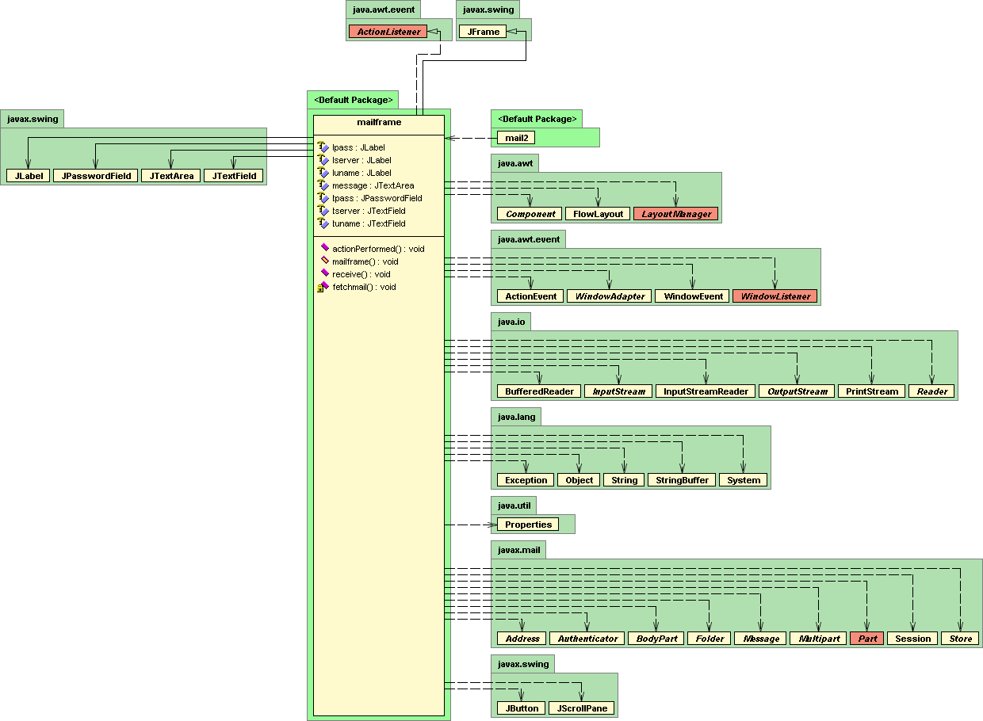

Slide 19
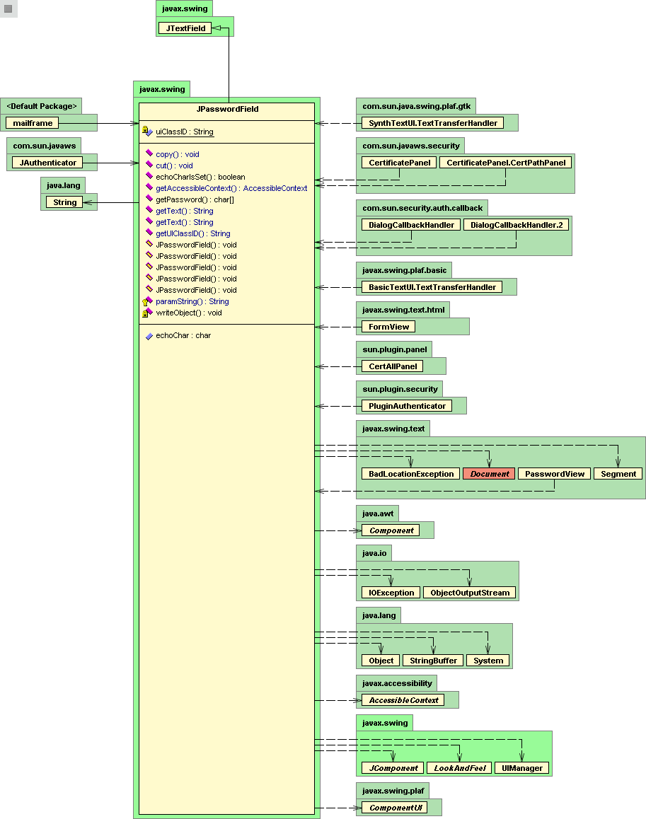

Slide 20
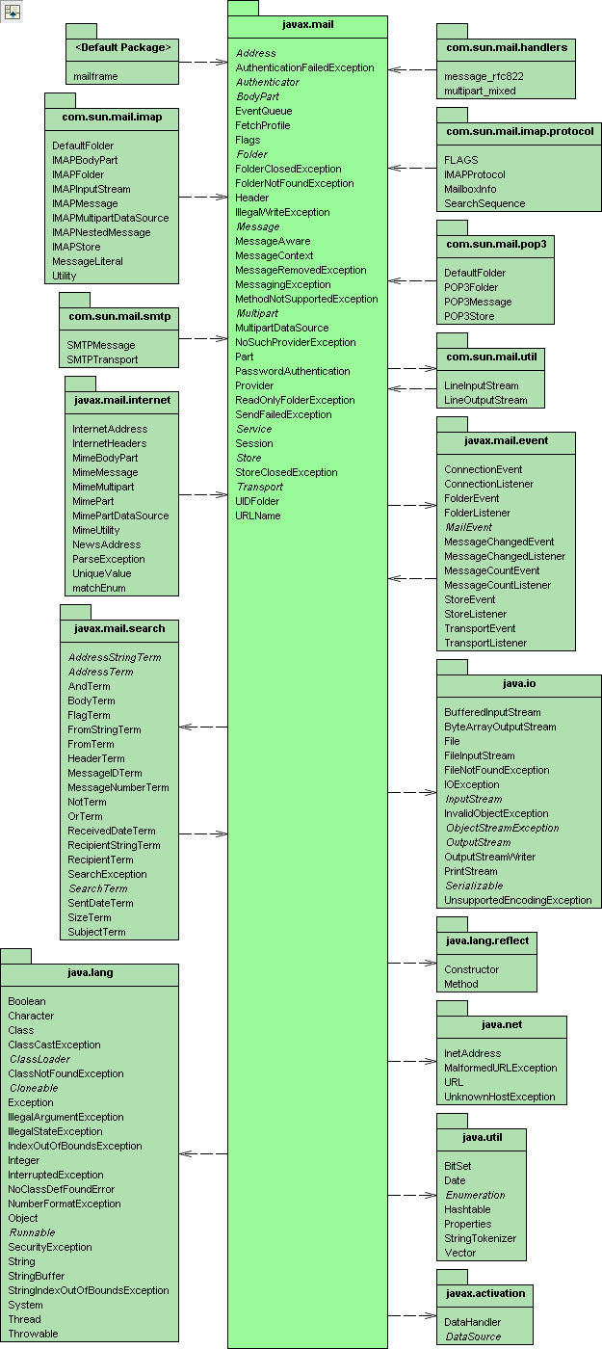

Slide 21
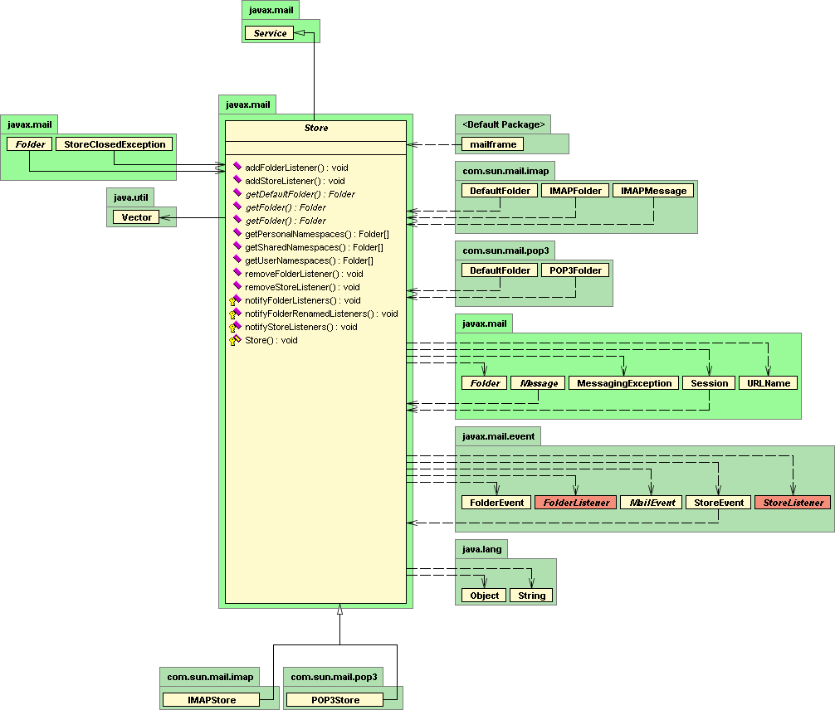

Slide 22
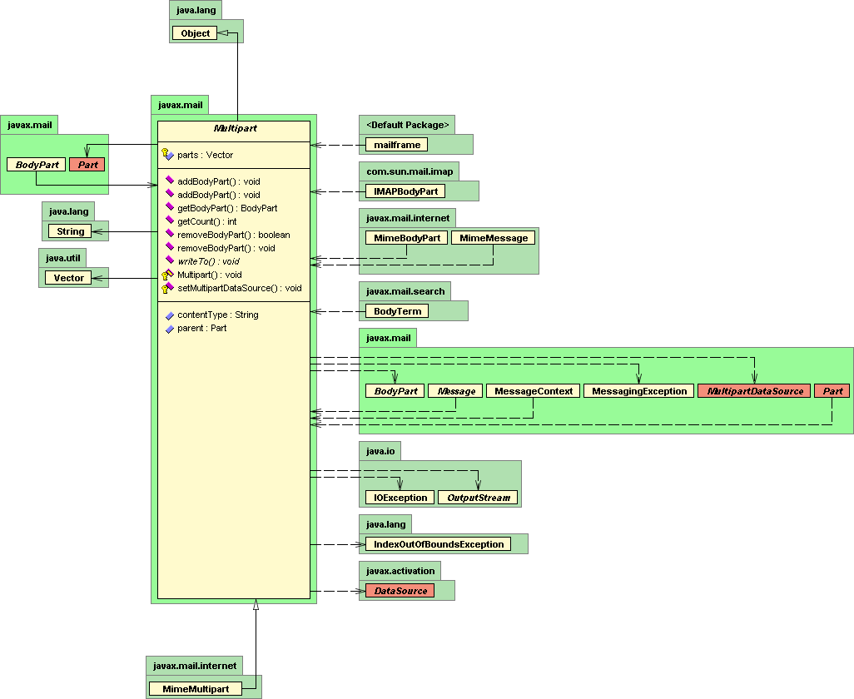

Slide 23
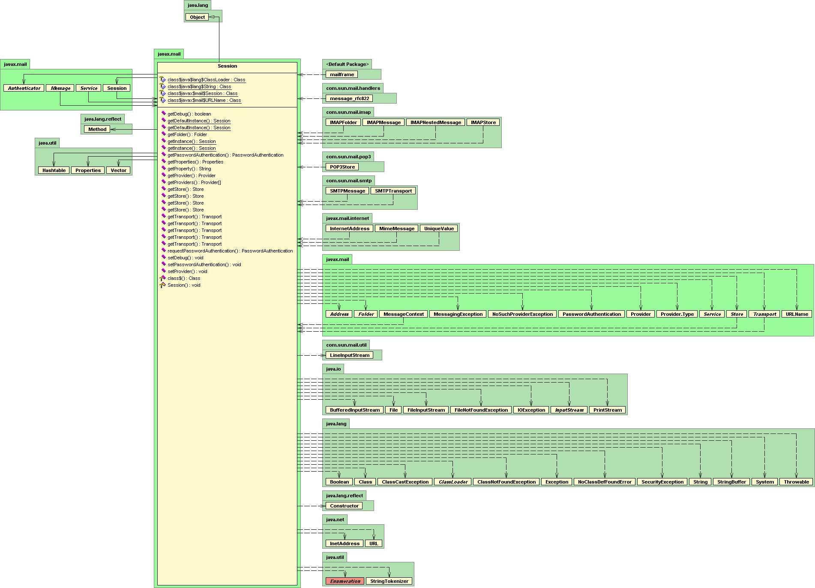

Slide 24
SCREENS

Slide 25
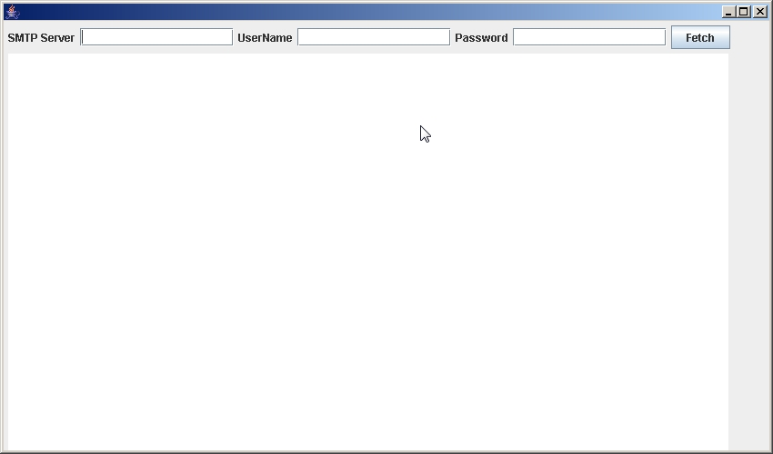
Login screen

Slide 26
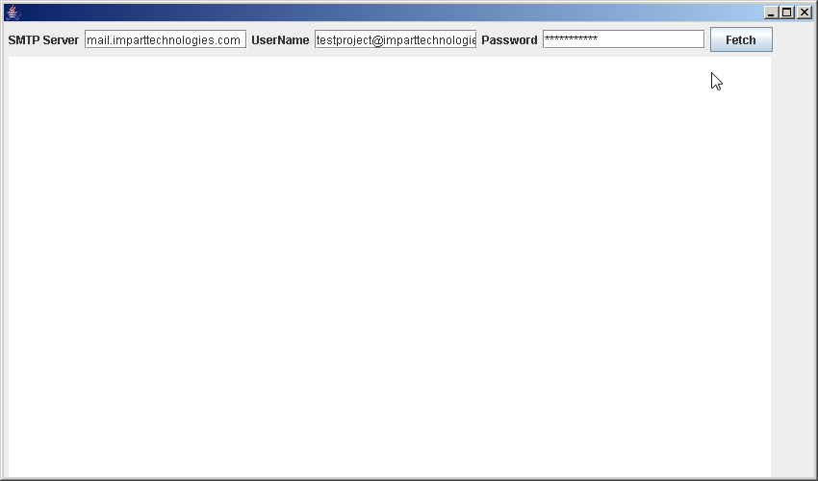
Login screen after details entered

Slide 27
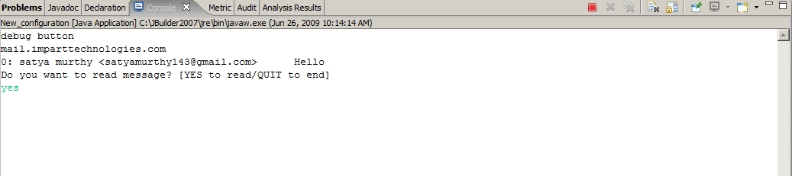
Mail Window

Slide 28
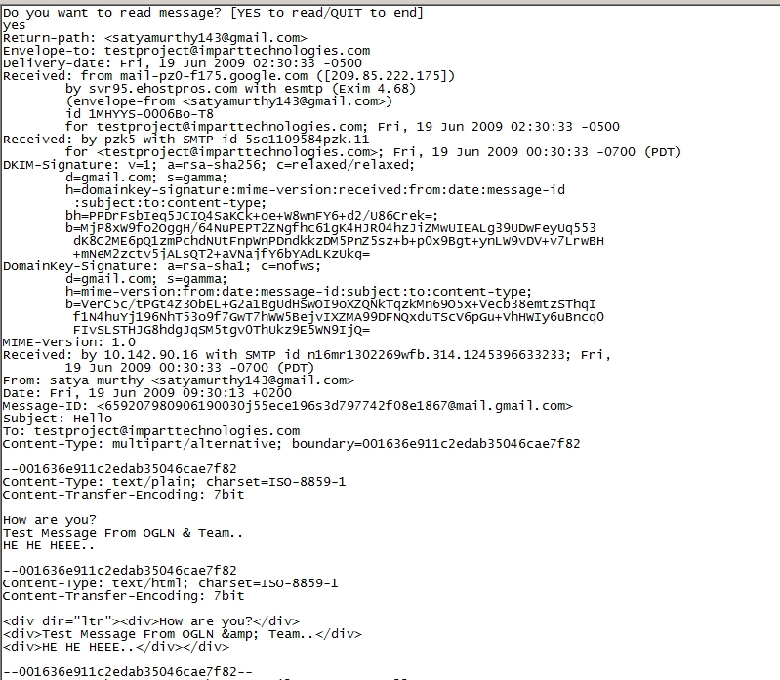
Get Mail

Slide 29
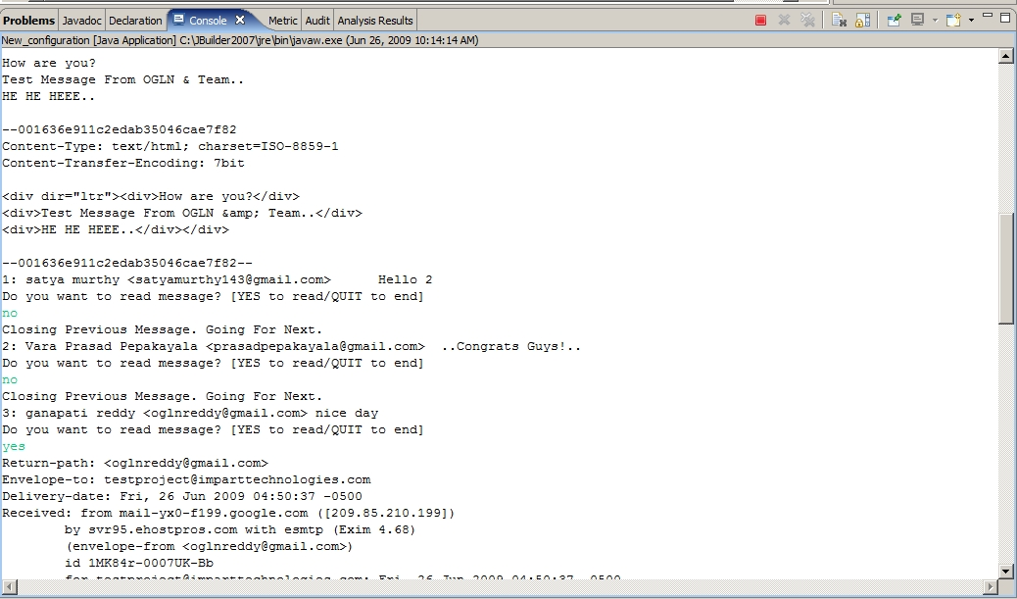
Messages

Slide 30
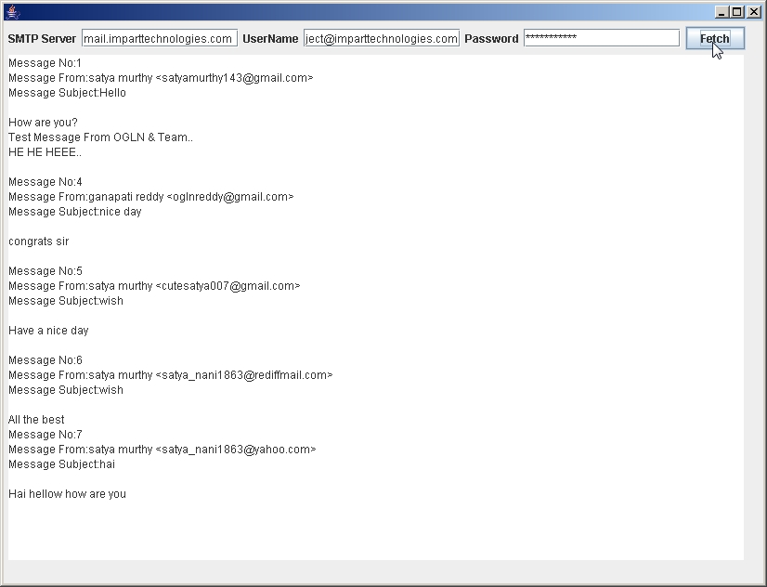
Messages

Slide 31
C
O
N
C
L
U
S
I
O
N
This project is used to read mails without a browser
This is highly protected as it is secure
The user friendly screens are provided

Slide 32
bibliography
JAVA COMPLETE REFERENCE
-Schildt
Thinking in JAVA
-Bruce Eckel
www.google.com
www.wikipedia.org
www.encyclopedia.com

